Slide 1
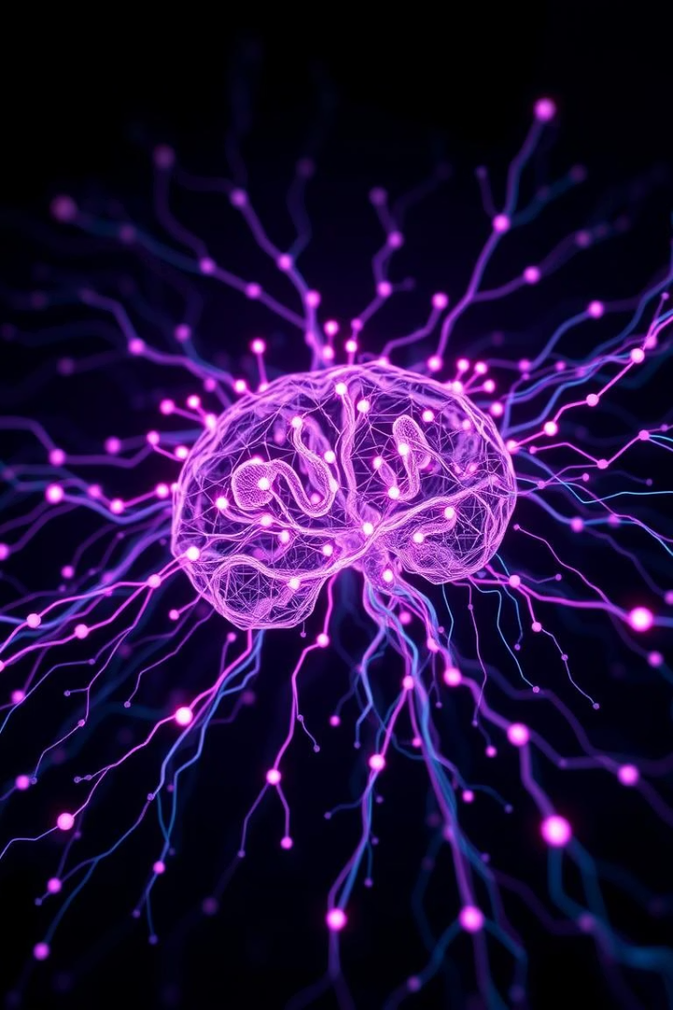
Detecting Fake News with NLP
Combating misinformation using AI and machine learning is crucial. The increasing prevalence and impact of fake news demand effective solutions. NLP techniques are vital for identifying and mitigating fake news.

Slide 2
The Role of NLP in Fake News Detection
NLP Fundamentals
Feature Extraction
NLP Models
Natural Language Processing (NLP) enables computers to understand human language. Key techniques include text classification and sentiment analysis.
TF-IDF and word embeddings like Word2Vec, GloVe, and BERT transform text into numerical features. These are essential for model input.
Logistic Regression, SVM, Naive Bayes, RNN, and Transformer models are commonly used. Each offers unique strengths for fake news detection.

Slide 3
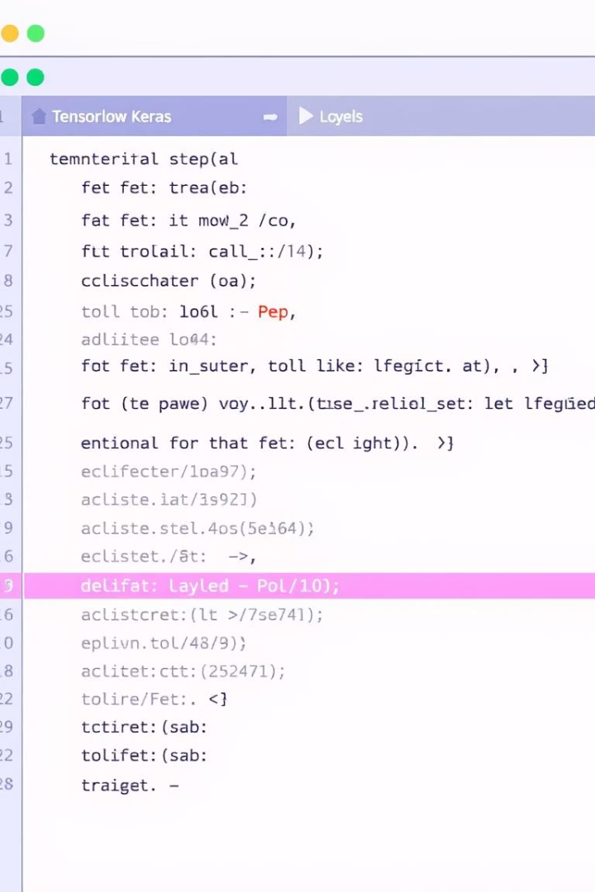
TF-Keras Model Example
Define Layers
Set up the model with Embedding, LSTM, and Dense layers for processing text data.
Compile Model
Configure the model with an optimizer, loss function, and metrics for training.
Train and Evaluate
Train the model using model.fit and evaluate its performance with model.evaluate.

Slide 4





Challenges and Future Directions
Overfitting & Generalization
Imbalanced Datasets
Models must generalize well to new, unseen fake news data. Avoiding overfitting is a continuous challenge.
Addressing skewed data distributions is critical for accurate model training and reliable predictions.
Explainable AI (XAI)
Real-time Detection
Understanding model decisions helps build trust and improve detection strategies, especially in sensitive areas like fake news.
Developing systems for instant identification and intervention is essential to combat rapidly spreading misinformation.

Slide 5





Conclusion
NLP Effectiveness
Powerful Platforms
Continuous Improvement
NLP is highly effective for detecting fake news. It offers robust tools for text analysis.
TF-Keras and PyTorch provide powerful frameworks. They enable advanced model development.
Constant vigilance and model refinement are vital. We must adapt to new misinformation tactics.
Collaboration is Key
AI experts and journalists must collaborate. This synergy ensures comprehensive solutions.

